Slide 1
PYTHON PROGRAMMING
LAUNCHCODE
July 19, 2025
Asfand Khan

Slide 2
Homework Links
https://github.com/Asfandyar-Khan/LaunchCode/
Contains syllabus
Contains lectures
Powerpoint files
Google Colab
Contains homeworks
Word document
To be completed prior to class
Any unfinished or challenging questions are taken up at the start of class
Let’s take a look at last week’s homework!

Slide 3
Review of Past Class
Understanding the difference between string and int/float
Give an example of a string and a float value
Can string values be converted into integers? Vice versa?
Variables and Statements
What is a variable? Provide an example. (show next slide)
What is a statement? How is it different from an expression?
What does the round() function do?
What does the abs() function do?
What does the type() function do?
Let’s do a knowledge check next!

Slide 4
Python Variables Review
A variable in python is a name that refers to some value
Variables must not begin with a number
Variables are case-sensitive (lower case only)
Use the equal sign (=) to assign a value to your variable
Variables can contain both letters and numbers
Use type() to check your variable’s data type

Slide 5
Knowledge Check
Create a variable named name and assign it your first name as a string (e.g., "Bob").
Create a variable named age and assign it your age as an integer (e.g., 12).
Print out a sentence that combines the two variables using print(). For example:
"Hello, my name is Bob and I am 12 years old."

Slide 6
Topics to Cover Today
1. Advanced String and Print Exercises
Using strings
Using numbers
Using a variable in a string
2. Input Function
3. Chapter 3 – Functions
What is a function?
How is a function called?
What is the syntax of a Python function?
What is a for loop and how is it used in a function?

Slide 7
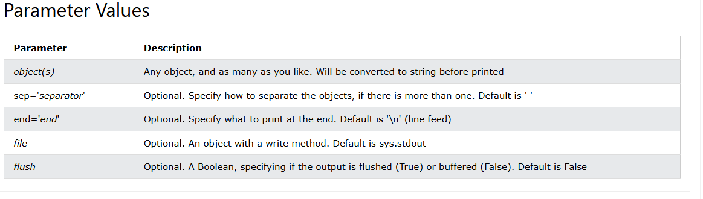
Print Function - Syntax
The following is how a print() function is structured
print(object, sep=separator, end=end, file=file, flush=flush)
Notice optional vs. object(s)!

Slide 8
Print Function - Syntax
Let’s do some examples in Google Colab!

Slide 9
Input Function
Input Instruction: To take an input from user through keyboard input() command is used, this instruction take input from keyboard in the form of ASCII character and store it the variable.
Syntax:
take_input = input(1 Argument)
name = input('Enter your name =')
age = input('Enter your age = ')
print('Your name is ', name , ',and your age is = ',age)

Slide 10
What is a function?
So far we’ve looked at many different functions
print(), type(), int(), float(), str(), abs(), round()
A function is a sequence of statements that run when it is called
Python has many different built-in functions, like examples above
However, we can build our own functions!

Slide 11
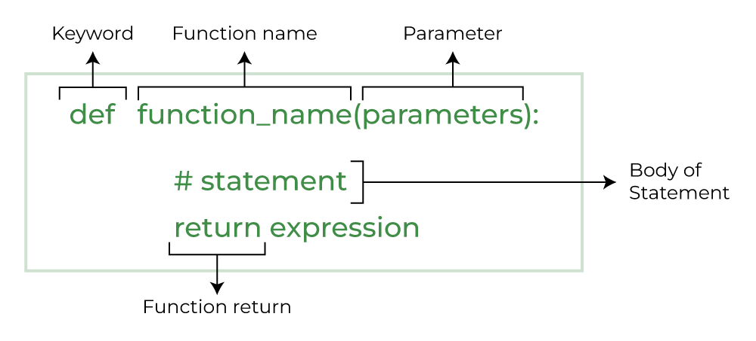
Defining New Functions
Function definition – helps us specify the function
Syntax:

Slide 12
Defining New Functions, cont’d.
The keyword helps us initialize a function
The function name is the name which you use to call the function
The parameters include the number of variables within the function
The return is the value that comes out of the function
Notice the syntax/structure of how we name functions!

Slide 13
Defining New Functions, Example
Write a function that outputs a few of the introductory sentences we covered earlier in the class
Def favourite_sentences():

Slide 14
Review and Questions
Homework will be posted tomorrow!
Asfand Khan

